Slide 1

Capstone 2 Music Recommendation App
Supervisor : Marcos BittenCourt

Slide 2
Music Recommendation App’s Team

Slide 3
Problem statement
This is time consuming and difficult to find your favorite music . There are lot of options available and user waste a lot of time finding their favorite music.
Recommender system has the ability to predict whether a particular user would prefer an item or not based on the user's profile. Recommender systems are beneficial to both service providers and users. They reduce transaction costs of finding and selecting items.
The goal is to implement the content-based filtering to build a comprehensive recommender system. Recommender system should suggest music based on personal preference and experience.

Slide 4
Executive Summary
Recommendation system is a program/system that tries to make a prediction based on users’ past behavior and preferences.
Recommendation systems are typically seen in applications such as music listening, watching movies and e-commerce applications where users’ behavior can be modeled based on the history of purchases or consumption.
Recommendation system benefits a user in many ways because of its nature of prediction, value-add, and ease of consumption.
A user would not have to spend hours to decide about a particular movie or music or a product. The relevant and useful content gets delivered to the user at appropriate times.
Our aim is to build such a recommendation system using the existing tools and technologies.

Slide 5
Rationale Statement
We see an explosion of Music streaming apps these days and sometimes wonder how we get the relevant set of songs when we open the application. These are recommendation systems which are based on previous watching/listening history and feedback.
Most of them work based on Collaborative and Content-based filtering.
Our target is to build a music recommender app who can predict songs or podcast as per user choice, by using machine learning and deep learning algorithms. Music recommender system would be trained and tested accurately to meet the required necessity.

Slide 6
List of Tasks
Literature Survey
Dataset collection
Data cleaning and pre-processing
Data visualization
Algorithm selection
Designing Recommender Architecture
Implementation of the algorithms
Quantitative analysis of the results

Slide 7
Approach:
we will use content filtering and collaborative filtering for recommendation of music.
Homepage Recommendations
Homepage recommendations are personalized to a user based on their known interests. Every user sees different recommendations.
Related Item Recommendations
Related music recommendation are recommendations like a particular song. Users looking for a song may also see a list of related music.

Slide 8
Dataset:
Data set selected from Kaggle competition “WSDM-KKBox Music Recommendation Challenge”.
train.csv
msno: user id
song_id: song id
source_system_tab: the name of the tab where the event was triggered. source_screen_name: name of the layout a user sees.
source_type: an entry point a user first plays music on mobile apps. An entry point could be album, online-playlist.
songs.csv
The songs. Note that data is in unicode.
song_id
song_length: in ms
genre_ids: genre category. Some songs have multiple genres, and they are separated by |
artist_name
composer
lyricist
Language
members.csv
user information.
msno
city
bd: age. Note: this column has outlier values, please use your judgement.
gender
registered_via: registration method
registration_init_time
expiration_date:
song_extra_info.csv
song_id
song name - the name of the song.

Slide 9
Machine Learning Algorithms:
KNN
LightGBM
Deep Learning (optional)
Tools/Technologies/Frameworks:
Python 3.7
Java 1.8
Jupyter Notebook 6.0.0
Azure ML studio
Javascript Frameworks for UI
NOSQL DB for Application Backend.
Rest service in python
Github
Assumptions & Constraints
It is challenging to understand the mathematical formulae, derivations and concepts behind content based and collaborative filtering.
The understanding of the dataset and the relevant features are time consuming.

Slide 10
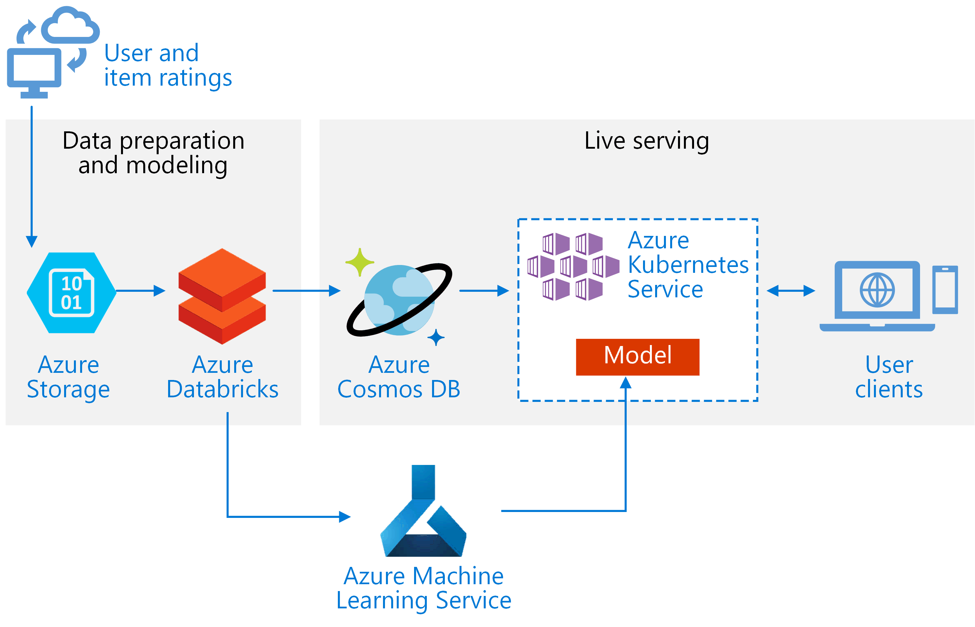
Solution Design
Music App: UI consist of User profile, User Preference, User Playlist . These details persist in NoSQL DB.
Music ML: Trained Machine Learning model deploys on Azure ML.
Music App calls rest service exposed from Music ML model for music recommendation.
Reference Architecture for building solution on Azure Cloud shown in fig.

